Slide 1
Deep Learning for Single Cell Analysis
Group Members
Ziyang Ding , Undergraduate,
Ziyang.ding@duke.edu
Chaofan Tao, Undergraduate,
chaofan.tao@duke.edu
Kuei Yue Ko, project manager,
kuei.yueh.ko@duke.edu
Cliburn Chan, project lead,
cliburn.chan@duke.edu
Single cell analysis dedicates to apply data driven methods to cluster and classify cells using unsupervised learning in order to help scientist to discover new cell types. The project suggests using autoencoder as deep learning approach for single cell analysis and builds a user interface for single cell analysis uses.

Slide 2
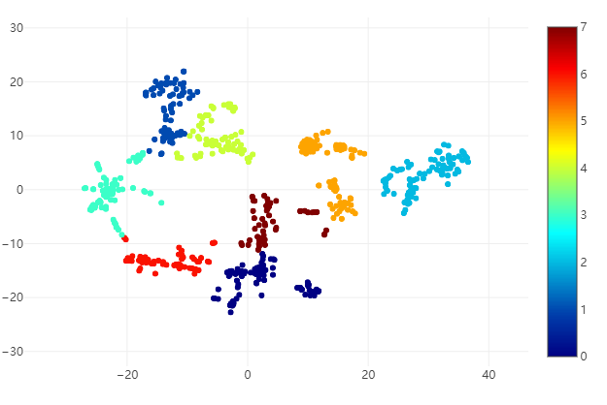
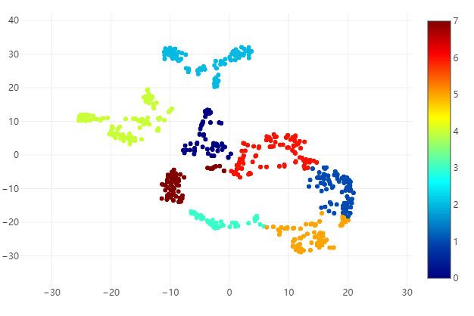
Raw data
Data Cleaning
Dimension
Reduction
Clustering
Visualization
pbmc 3000
Airway
Gland
Your own data
…
mingene
mincell
Dispersion
Log1p
…
no reduction
K-means
Affinity Propagation
Hierarchical
Agglomerative
Clustering
tSNE
SCVIS
PCA
Autoencoder
…
…
…
Pipeline 1: no reduction
Pipeline 2: PCA reduction
Pipeline 3: Autoencoder reduction
Pipelines
We suggest 3 pipelines for single cell analysis, among which differs in dimension reduction methods. The PCA and Autoencoder did well in preserving local structures.
Autoencoder (left) and PCA (right) for Gland

Slide 3
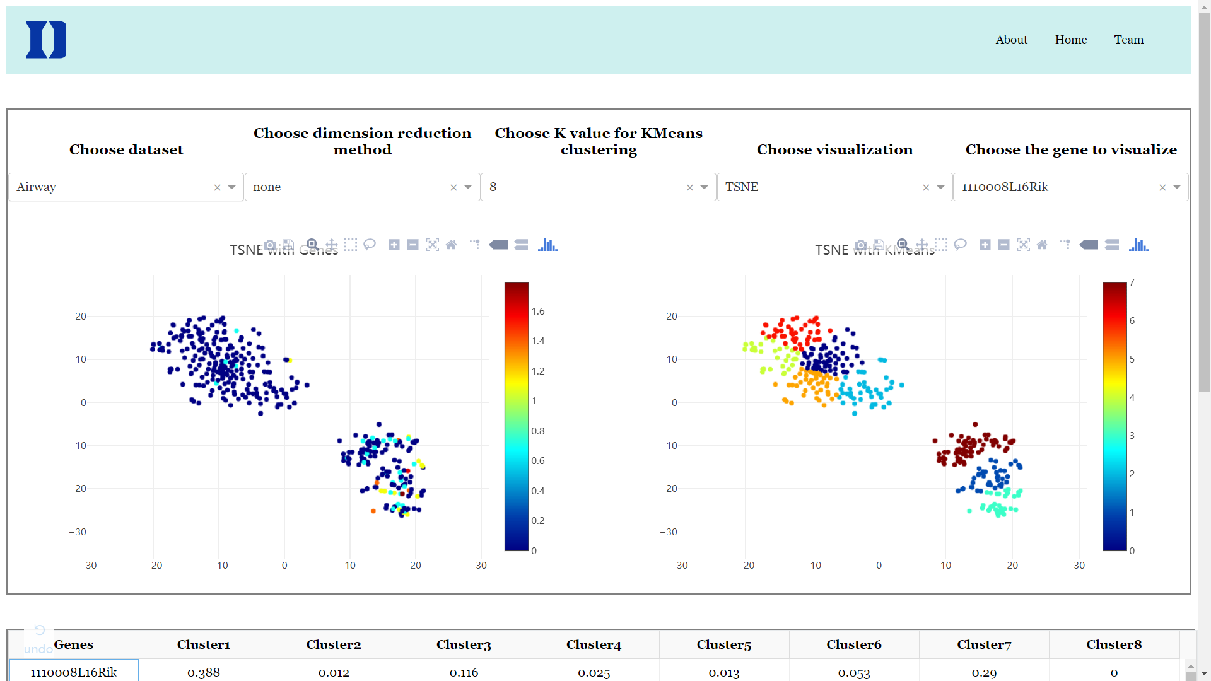
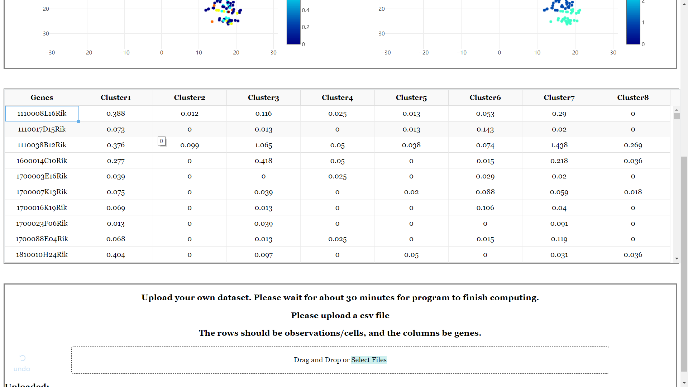
User Interface
The data pass through the entire 3 pipelines and will be visualized on the UI panel. The left panel shows UMI count for in each cells for a specified gene on the upper right; the right panel shows clustering color mask for the dataset with K specified above.
We built a user interface(web app) for biologist to visualize their own single-cell sequencing data. The user interface consists of three pages: Home, About and Home.
We also allow users to upload dataset as well as using preloaded dataset, change dimension reduction methods, change K-value for clustering, and change visualization method. The mean UMI value for each cluster is also demonstrated as a table, which can be automatically sorted by user’s choice. This helps biologists to identify the principle component gene of each cluster, so that the new cell type can be more easily identified and understood.

